Slide 1


Design and Analysis of Data Structures and Algorithms
Data Structure Fundamentals
Presentation by
Lyernisha S R

Slide 2
Data structure fundamentals

Slide 3
Contents
General comments on DATA STRUCTURES – what are data structures?
General sequences and lists
Arrays – 1, 2, multi-dimensional and parallel
Stack and queues overviews
Linked lists overview
Graphs and trees overviews

Slide 4
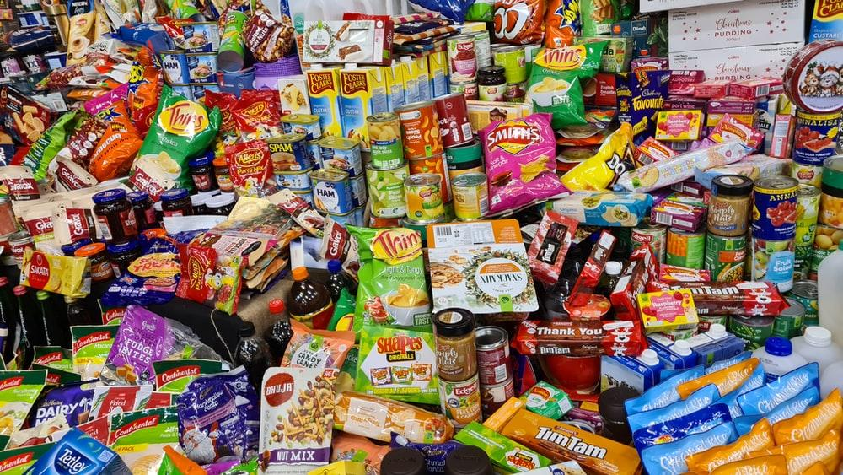

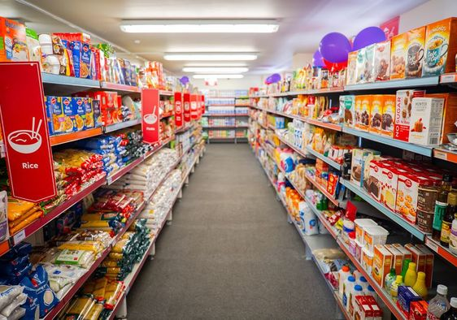
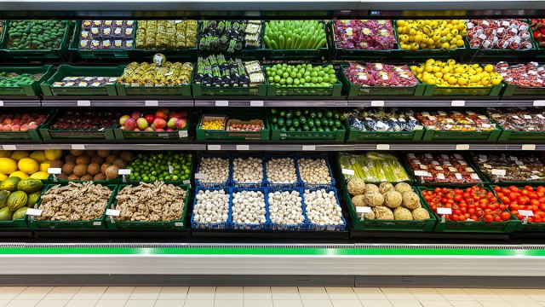
Introduction

Slide 5
Introduction
What is a data structure?
A data structure refers to how data is organized.
A data structure comprises a number of data items or elements linked by some common attribute or relationship.
What is unstructured data?
Data that is unstructured has no logical organization; it makes no sense to us; the semantic content of the data is then harder to determine;
It exhibits no hierarchy.
Why structure data?
We impose structure on data to make it easier to process it, such as in searching, comparing, exchanging, etc
How we can structure data?
Adding classifications, taxonomies, and hierarchies are the most common data structuring processes

Slide 6
Unstructured Data- Example
Mohammed
Hanimaadhoo
Programmer
Ali
Designer
21
28
Hulhumalé
23
Malé
Ibrahim
Developer
Ahmed
25
IT Support
Milaidhoo

Slide 7
Data structures
Structures such as these help to:
Maintain
Sort
Search
data collections.
Name | Age | Profession | Address
Mohammed | 28 | Designer | Hanimaadhoo
Ahmed | 21 | Programmer | Hulhumalé
Ibrahim | 25 | IT Support | Milaidhoo
Ali | 23 | Developer | Malé

Slide 8
Unstructured Data- Example
Unless it is totally random, most collections of data exhibit logical relationships
The unstructured data shown does exhibit such relationships once we examine them
Unstructured data can then be structured into records or classes
In this case, personnel records that abstract into classes of data, such as name, age, profession , and address(Attributes of the class)

Slide 9


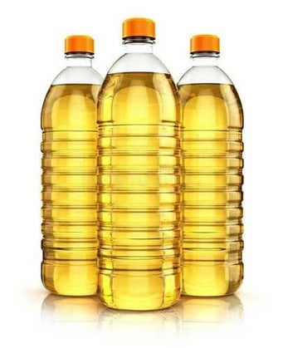

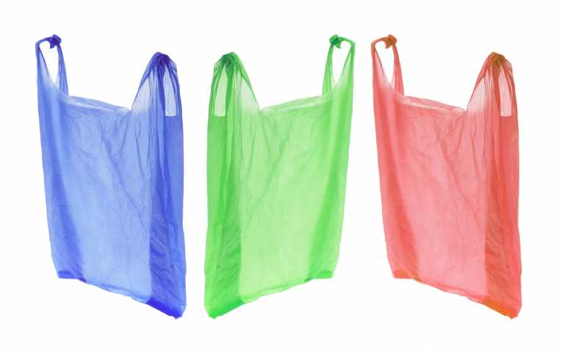
Example:

Slide 10
Why data structure?
We devise algorithms to STRUCTURE data to enable other algorithms to PROCESS the data.
Note:
A given data structure is a particular scheme for organising related data items.
As algorithms operate on data, the way the data is organised is very important and critical to efficient processes of searching and sorting.
Different types of data structure reflect the nature of the data being organised.
Data structures may also reflect the nature of the computing problem being addressed
Each data item can contain 1 or more attributes or fields that can uniquely identify it.
Data items can be stored and accessed in a variety of ways.

Slide 11
Data representations
In semester I students from A subject got 76 pass percentage. In semester II they scored 78%.In semester III their score is 60%. In semester I students from B subject got 63 percentage. In semester II they scored 82%.In semester III their score was 74%.In semester I, students from C subject got 81 %.In semester II they scored 84%. In semester III their score was 79%
Sem
 | I | II | III
A | 76 | 78 | 60
B | 63 | 82 | 74
C | 81 | 84 | 79
Sub

Slide 12
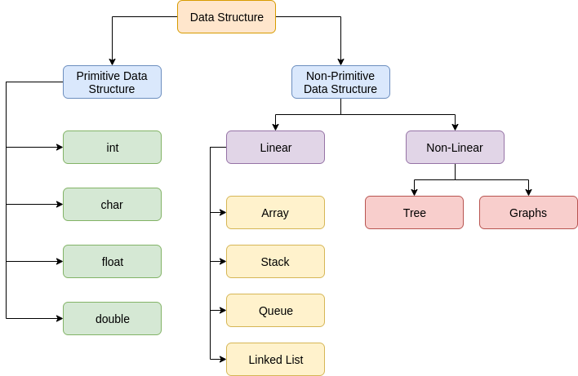
Data Structure hierarchy

Slide 13
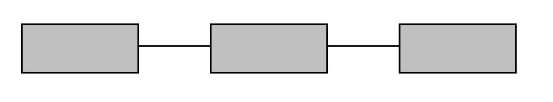
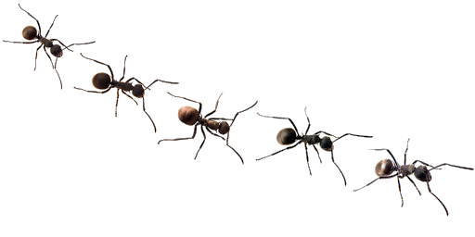
Types of linkage or data item connectivity
Linear Data structure
While traversing sequentially only one element can be reached directly from another
e.g. Arrays, list, stacks, queues

Slide 14
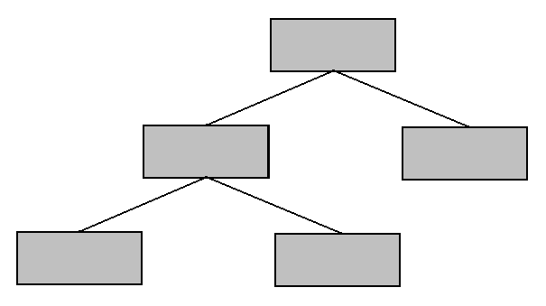
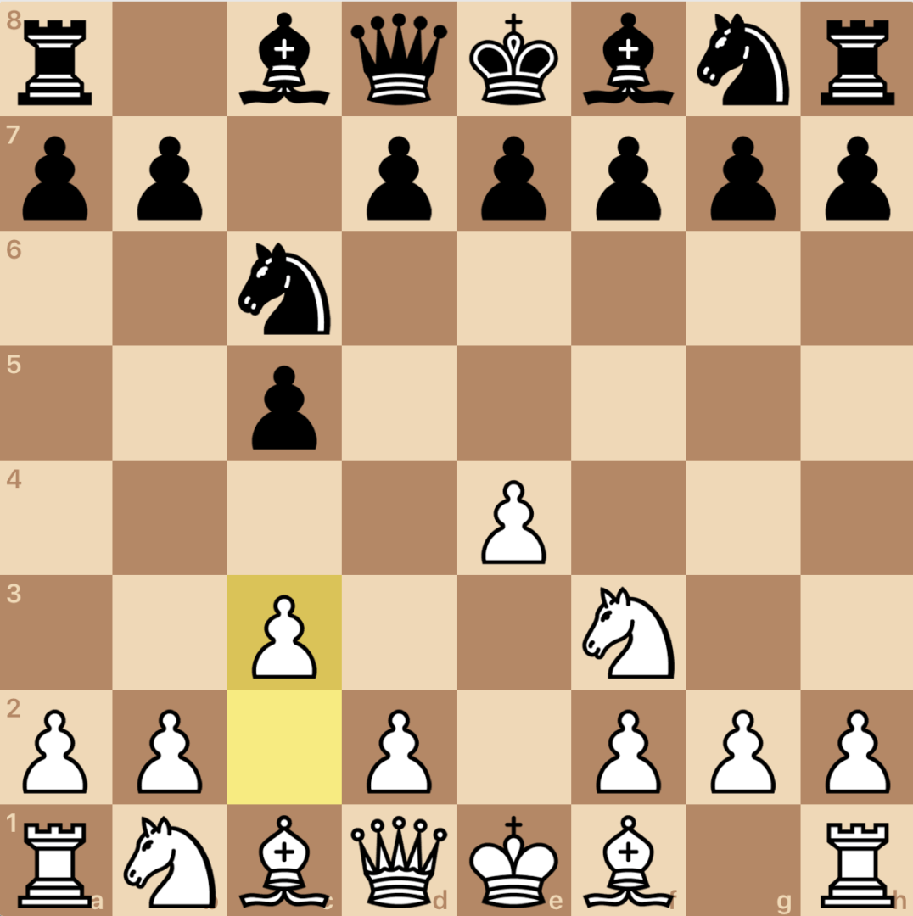
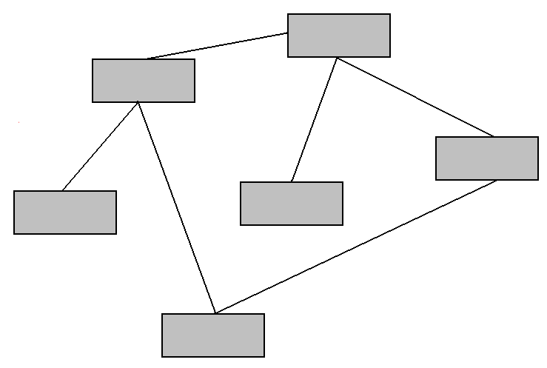
Non-linear Data structure
While traversing from one element we can reach more than one element directly.
E.g. Trees and graphs
Hierarchical or trees
Network or graphs

Slide 15
Types of data structure – memory usage
Static – Fixed size, structure, memory location
Dynamic – memory can shrink or expand based on the data
STATIC DATASTRUCTURE
General sequences and lists
Arrays
DYNAMIC DATASTRUCTURE
Linked lists
Stacks
Queues
Trees
Graphs

Slide 16
Operations on data structures
Traversal of data structures.
Going through the set of data to process it in some way.
Such processes include:
Addition or inserting of data
Deletion of data
Sorting of data
Searching the data
Merging different sets of data
There are various algorithms associated with these processes.
Data structures and algorithms are tightly connected and related.

Slide 17
Static data structures
In Static data structure the size of the structure is fixed.
The content of the data structure can be modified but without changing the memory space allocated to it.
General sequences and lists
Arrays

Slide 18
General sequences and lists:
Sequences:
Sequences are one of the simplest of data structures
A sequence is a set of items such that each item has a successor (except the last) and a predecessor (except the first).
Examples of sequences:
An English word which is a sequence of letters
English text which is a sequence of words
A number which is a sequence of digits
A railway train which is a sequence of carriages
A telephone directory which is a sequence of names and addresses and phone number
This data structure is useful when data items are processed one after another.
Simple algorithm for processing a sequence:
Start at beginning of sequence
While NOT(end of sequence) do
process next item

Slide 19
General sequences and lists:
Lists:
Lists are more or less synonymous with sequences:
Linear data structures – these are the foundation blocks for most data structure design
One of the most common and simplest data structures
Often synonymous with the one-dimensional ARRAY data structure
Data items are stored one after another
Lists appear in a variety of situations all the time:
Guest lists, grocery lists, class lists, things-to-do lists, employee lists, stock lists

Slide 20
General sequences and lists:
Lists are characterized by:
Data items are organised linearly – each item except the first has a unique component that follows it and each item except the last has a unique item that precedes it
Exhibit important relationship of NEXT and PREVIOUS between data items, as with sequences
Lists come to us in different lengths – short, long, very long, etc
Operations associated with lists include:
Insert – add an item to list
Delete – remove an item from the list
Find or Retrieve – search for an item in the list
findLength – obtain the length of the list
Compare – enables data items to be compared for certain types of manipulation

Slide 21
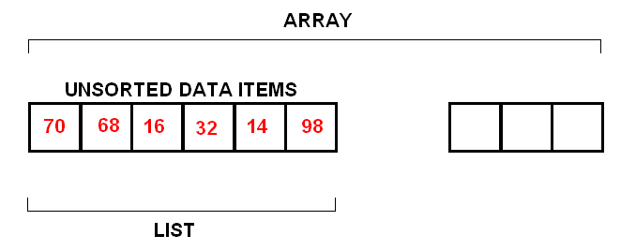
List vs. Array
A list is NOT really an ARRAY.
An array is a built-in programming construct that usually has a fixed length. Whereas a list is an abstract entity of variable length.
But a list can be implemented by using an array:
Lists can be represented in essentially two different ways:
Contiguous representation or linear list – items are stored in the order in which they occur. This is a physical organisation.
Non-contiguous, linked lists – items are not stored in the order in which they occur or are input, rather, each item holds an additional data field, or pointer, to another item held in the list at a non-contiguous position.
This is a logical organisation. It is in this sense that lists can be considered a more complex type of sequence.

Slide 22
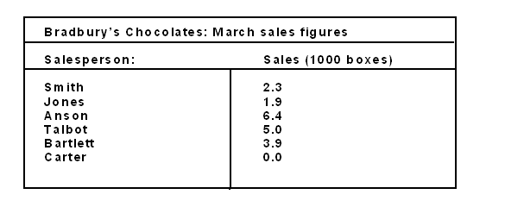
Linear Lists
Consider the following list containing sales figures:
The list of numbers is called a linear list: 2.3, 1.9, …0.0.
The raw numerical data is not useful until structure and meaning is imposed on the given table.
At this point the raw data becomes information.
Namely, 3.9 means salesperson Bartlett sold 3900 boxes of chocolates in March.

Slide 23
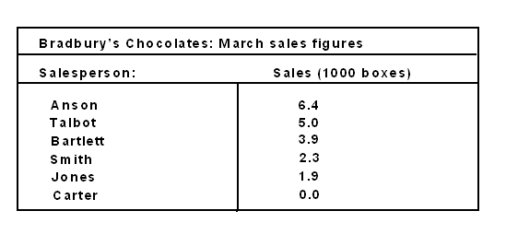
Linear Lists
The given list is in no particular order.
To ease certain kinds of data retrieval, the list would need to be sorted in some way.
For example, what if the employer sought to find out which employee was performing the best, then second best, and so on?
In this case, the list would need to be sorted into descending order of magnitude of sales, thus:

Slide 24
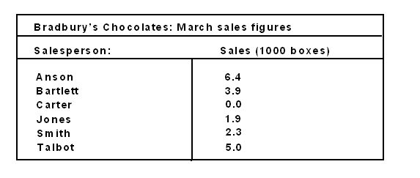
Linear Lists
Alternatively, an alphabetical arrangement might be required:
All these orders or arrangements form linear lists, but some are more useful than others, depending on what the user seeks to extract from them.

Slide 25
Linear Lists
Linear lists have N sets of information, where N>= 0.
We can assign an identifier to each element of the list.
In this example, S is an appropriate label signifying SALES.
A subscript can be used to identify each element.
Taking our original sales data:
S₍₁₎ = 2.3, S₍₂₎ = 1.9, … S₍₆₎ = 0.0
Subscript notation corresponds closely to how such data is actually stored in a machine, as an ARRAY.
An element in the list is referred to as the i^{th} element.
So if i = 3, then we are referencing the third element which is S_{(i)} = S₍₃₎ = 6.4

Slide 26
List ADT:
List ADT supports the following methods or operations on a list S:
First() : return the position of the first element of S; return error if list is empty
Input: none; Output: position
Last() : return the position of the last element of S; return error if list is empty
Input: none; Output: position
isFirst() : return a Boolean value indicating whether the given position is the first one on the list S
Input: position p; Output: Boolean
isLast() : return a Boolean value indicating whether the given position is the last one on the list S
Input: position p; Output: Boolean
before(p) : return the position of the element of S preceding the one at position p; an error occurs if p is the first position
Input: position p; Output: position
after(p) : return the position of the element of S following the one at position p; an error occurs if p is the last position
Input: position p; Output: position

Slide 27
List ADT - Other update methods
replaceElement
swapElement
insertFirst
insertLast
insertBefore
insertAfter
remove

Slide 28
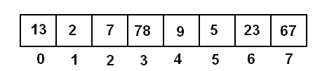
Types of Data Structure (Contd..)
Static data structures:
General sequences and lists
Arrays
Arrays:
Arrays are LISTS
One of the most fundamental and common data structures
Many of the algorithms we will examine function to process ARRAYS
An ARRAY of length 8:
Features of ARRAYS:
The individual items in an array can be identified by giving them a unique:
Indices or subscript
The elements of an array are thus stored according to their subscripts.
A row of numbers, for example, can be identified by its subscript:
num[1], num[2],…num[n]

Slide 29
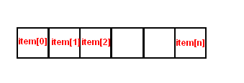
One-dimensional arrays
Simply a list of values.
Values called elements or components or items
1-dimensional array is a sequence or list of n items of the same
data type stored contiguously in computer memory and accessed
using indices described earlier:
Each element in an ARRAY can be accessed in the same
or constant amount of time.

Slide 30
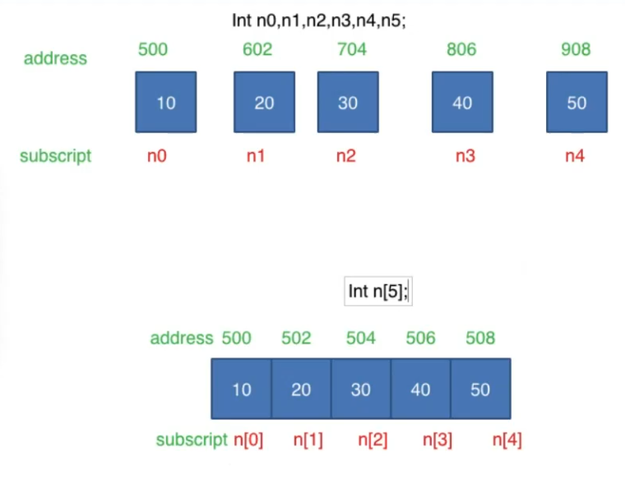
Array example
List
Array

Slide 31
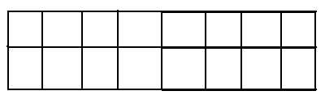
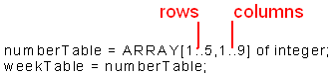
Multi-dimensional arrays
2-dimensional arrays:
Often represented as a table:
This data structure enables the storage of several lists in a single array.
Suppose one wished to store a series of temperature fluctuations, hour by hour, over a 5-day period.

Slide 32
Multi-dimensional arrays (Contd..)
numberTable has been defined as a 2-dimensional ARRAY with 5 rows and 9 columns (representing a 5-day period with 9 hourly readings per day)
In each cell or position in the ARRAY a value is stored. A typical value is stored in weekTable thus:
weekTable[2,5] is 86. [2,5] are coordinates in the data structure. Thus, to access an element in a cell, two indices or subscripts-coordinates - are required.
 |  |  |  | 86

Slide 33
Dynamic data structures
Dynamic data structures have sizes, structures and memory locations that can shrink or expand, depending on the use.
Linked lists
Stacks
Queues
Trees
Graphs

Slide 34
1.Linked list
Linked list is a set of nodes where each node has two fields
Data: actual piece of information stored
Link: stores the address of the next node
Example
DATA | NEXT ADDRESS
Current address
HEAD
TAIL
10 | 5021
40 | 5014
20 | 5038
30 | NULL
5001
5021
5014
5038

Slide 35
Linked list (Contd..)
Linked lists are dynamic data structures holding sequences of data exhibiting the following
characteristics:
Data items are not necessarily represented in contiguous form
A NODE contains two types of information: data and one or more links referencing other NODES in the linked list.
Information field contains the actual data, and the link field the address or location of the next data item in the sequence
Link field in final item indicates end of list
First and last node usually called HEAD and TAIL
The principal benefit of a linked list over a conventional array is that the list elements can easily be inserted or removed without reallocation or reorganization of the entire structure because the data items need not be stored contiguously

Slide 36
Linked lists Types
Singly-linked List
List has only one link that points to next node
Doubly-linked List
Each node has two pointers: prev & next or header & trailer
Prev: points to previous node, next : points to next node
10 | 5021
40 | 5014
20 | 5038
30 | NULL
5001
5021
5014
5038
PREV | DATA | NEXT
Current address
NULL | 25 | 5028
5010 | 35 | 5081
5028 | 45 | NULL
5010
5028
5081

Slide 37
When to use Linked List?
The number of nodes in a list is not fixed and can grow or shrink based on demand
Any application which has to deal with an unknown number of objects will need to use a linked list
To access a target node in a LINKED LIST:
Start with first node and traverse pointer chain until desired node is reached.
Time taken to access desired element, unlike in a standard array implementation, is dependent on where the node is stored
Main operations:
Insertion
Deletion

Slide 38
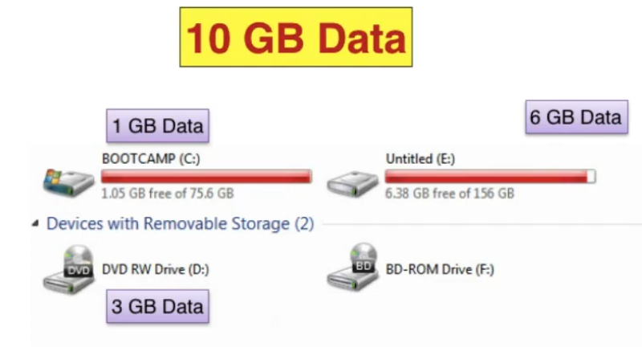
When to use Linked List?(Contd..)

Slide 39
2.Stacks
Stacks and Queues
Represent the simplest of data structures – but among the most important. They are central to many important computing environments
Stacks:
Type of SEQUENCE or LIST
Allows a limited number of INSERTION and DELETION operations
NEW items can only be added or inserted at the END of the sequence
Only the last item added in the sequence can be retrieved or deleted
Order of data items determined purely in terms of when the item was added
TOP – the end of the sequence where insertion and deletion operations can take place
The item that is removed from a stack is always the one that was added last or most recently – so a LIFO (Last In First Out)data structure

Slide 40
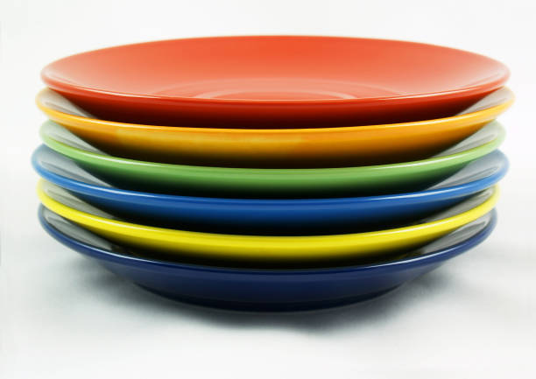

Stacks example
Pile of plates in a cafeteria – plates are removed from the top of the pile and clean plates added to the top of the pile:
Internet web browsers store recently visited sites, and user can go back to previous sites using back button:

Slide 41
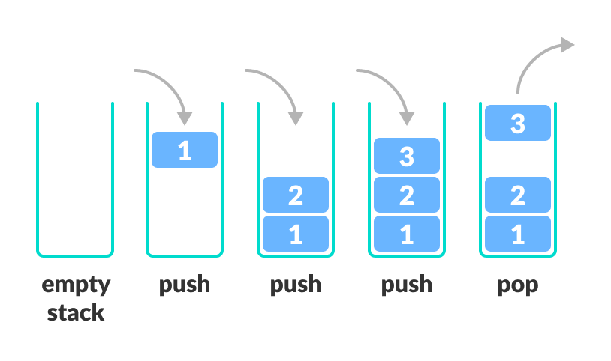
Stack operation
Stack operations/processing options/associated algorithms:
Insertion – called PUSHING
Retrieval – called POPPING
All these operations are applied to the top of the stack.
So no SEARCHING is necessary

Slide 42
Using stacks:
Implemented using following definitions:
1. One-dimensional array:
stack: array[1..5] of integer
2. An INDEX declaration to function as the index pointer:
TOP: 1..5;
3. Add or push an item onto stack
Ensure stack not full by ensuring:
TOP not = to 5
4. If not full, then increment TOP and transfer item to that location of ARRAY pointed to be TOP index.
18
11
10
1
5
TOP
4
3
2
1

Slide 43
Example:
To PUSH new item on to stack we need to access end of sequence.
Variable TOP is incremented to next unused position thus:
TOP = TOP + 1
Next, assign value we want to add to the stack to the array thus:
STACK[TOP] = 19
To remove or POP items de-increment the stack pointer:
TOP = TOP – 1
18
11
10
1
TOP
TOP
19
18
11
10
1
18
11
10
1
TOP

Slide 44
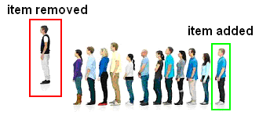

3.Queues:
A linear data structure or list or sequence or collection.
This data structure resembles a real-life QUEUE at a doctor’s surgery or supermarket check-out.
Patients arrive and sign in
The first patient in sees the doctor and is the first to leave
Data is added to the END of a Q – process called enQueue
Retrieved from the FRONT – process called deQueue

Slide 45
Queues(Contd..)
Other real-world examples:
Check-out supermarket lines, escalators, coin dispensers, and vending machines
Data can be inserted at any time, but only the element that has been in the QUEUE the longest can be removed at any time.
Called:
First-in-first-out or FIFO
It is a similar data structure to a stack.
In a FIFO data structure, the first element added to the queue will be the first one to be removed
Once a new element is added, all elements that were added before have to be removed before the new element can be removed.
Qs can be created using ARRAYS and LINKED LISTS
Insertion of data item occurs at list’s TAIL or REAR
Retrieval of data item occurs at list’s HEAD or FRONT

Slide 46
Stack vs Queue
STACK | QUEUE
An ordered list with only one end called TOP | An ordered collection of elements with two ends called FRONT and REAR
Insertion and Deletion can occur in only TOP | Deletion- Front Insertion - Rear
LIFO | FIFO
Eg:Stack of book/chair | Eg: Ticket window, standing in queue

Slide 47
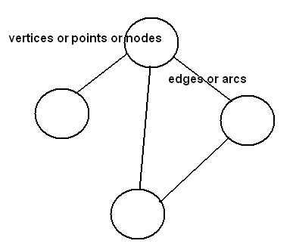
4.Graphs
Many problems can be expressed in the form of a graph.

Slide 48
Graph Terminology:
Formally:
Graph G = (V, E) defined as a pair of two sets:
Set 1: a set or collection of nodes or vertices - V
Set 2: a set of arcs or edges – E
Unordered vertices:
Here the pair of vertices (u, v) is the same as (v, u)
Here the vertices are considered ADJACENT
Connected by an UNDIRECTED EDGE
U and v are called ENDPOINTS of the edge connecting them
A graph is called UNDIRECTED if every edge in it is undirected
We can call this a two-way graph
Directed vertices:
Here the pair of vertices (u, v) and (v, u) are not the same
We say the edge (u, v) is directed FROM vertex u (the edges tail) TO the vertex v (the edges head)
We say the edge (u, v) leaves u and enters v
A graph whose every edge is directed is called DIRECTED
Directed graphs are called DIGRAPHS

Slide 49
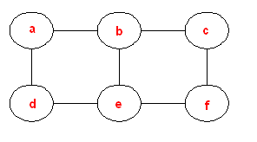
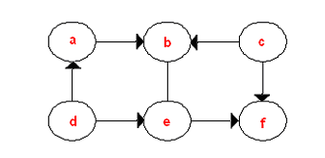
Types of graph
1.Undirected graph:
Every edge has no direction:
2.Directed graph/Digraph:
Every edge is directed, or has direction:

Slide 50
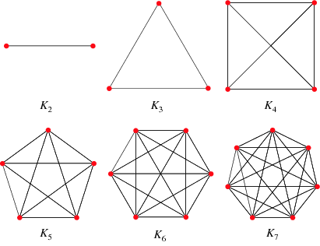
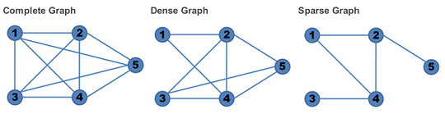
Types of graph (Contd..)
Complete Graphs:
When every pair of V is connected by an edge.
If there is N no of vertices then there will be n-1 no of edges
Dense Graphs:
When nearly all V are connected.
Sparse Graphs:
When few V are connected.
Complete Graphs

Slide 51
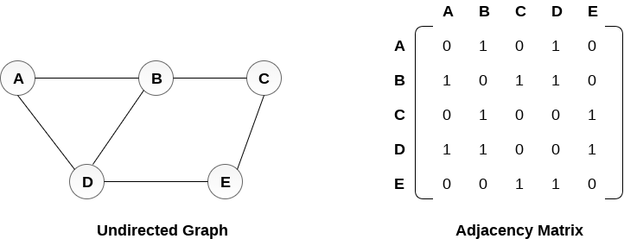
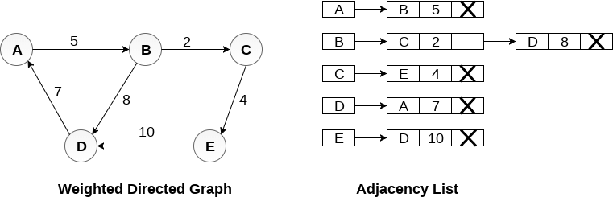
Graph representations
Two ways:
1.Adjacency matrix
– n x n Boolean matrix to express node connectivity
2.Adjacency list
– uses linked lists
Choice of representation used depends on:
Problem
Whether dense or sparse matrix – influences processing TIME

Slide 52
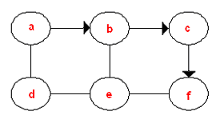
Paths and Cycles:
Traversing graphs
Simple paths:
When all V in the path are distinct – no V is visited > once
a,c,b,f = simple path:
Complex path:
When a V is visited > once.
a,c,e,c,b,f = complex path in previous G

Slide 53
5.Trees:
This is a HIERARCHICAL, non-linear data structure in that the data is more structured than a simple list and the data can be accessed in a variety of different ways.
Like many data structures, trees have a SINGLE starting point but thereafter offer many different routes of traversal through the data.
Trees have many advantages in data organisation. Their structure enables the implementation of processing algorithms that are faster than in lists, vectors, and sequences.
Trees have a natural correspondence to how we tend to organise information and phenomena.
By NON-LINEAR, we mean an organisation that goes beyond sequential before and after relationships between data objects.

Slide 54
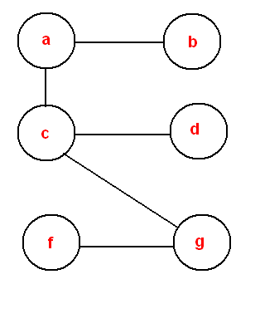
Trees – general observations
A TREE is a connected, ACYCLIC graph
All the vertices or nodes are connected to at least one edge
There are no cycles - hence acyclic

Slide 55
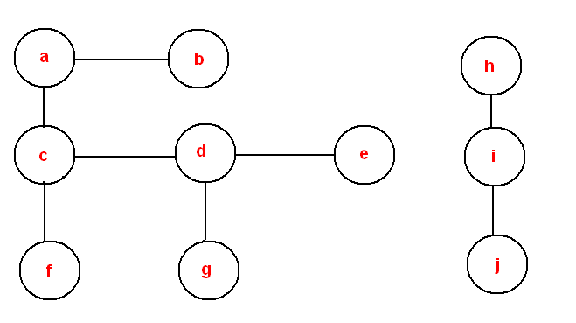
Forests
A forest is a collection of trees
Also acyclic but may not be connected
A forest:

Slide 56
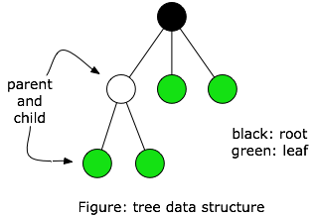
A simple tree:

Slide 57
Fundamental features of trees:
A tree is a data structure that is accessed beginning at the root node
Each node is either a leaf or an internal node.
An internal node has one or more child nodes and is called the parent of its child nodes. Also called inner node, i node, branch node
All children of the same node are siblings.
In an ORDERED tree all the children of each vertex or node are ordered L to R. There is a first child, second child, third child, etc.
Contrary to a physical tree, the root is usually depicted at the top of the structure, and the leaves are depicted at the bottom.
Root node forms base of tree and has no parent. Processing algorithms always start with the root node, as processing can only pass from parents to children

Slide 58
Fundamental features of trees(Contd..)
Connections between nodes are branches or edges
Child-parent relationships between nodes – parent and child nodes
Leaves have no children – leaf nodes or terminals
Nodes on same level hold sibling relationships
Nodes are external if they have no children – also known as a leaf. In other words, external because on the ‘edges’ of the tree structure
Nodes are internal if they have one or more children. In other words, they are tree components situated within the tree structure
Ascendant – A parent of a node in a tree, the parent of the parent, etc.
Descendant – A child of a node in a tree, any of the children of the children, etc.
Tree traversal - A technique for processing the nodes of a tree in some order, such as preorder traversal, in-order traversal, post-order traversal, level-order traversal.

Slide 59
Types of tree:
Binary
Multi-way
2-3 trees
B-trees
K-D trees
Sphere trees

Slide 60
Graph vs Tree
Graph | Tree
Hierarchical structure (Parent -Child) | Group of vertices connected by edges
There is a ROOT node | There is NO ROOT node
NO LOOP | Can be LOOPS
Represents RELATIONSHIP | Represents NETWORKS
Less complex | More complex

Slide 61
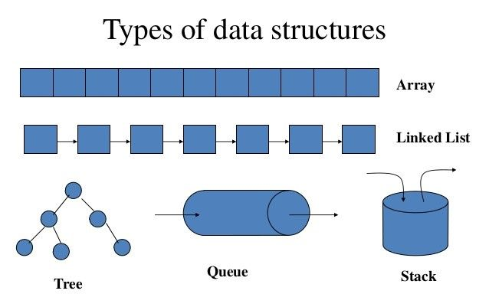
Recap
Graph

Slide 62
Thank you!

